Slide 1
Case Study Project: Boat Sales for Nearly New Nautical
By John Feng
Presentation for DataCamp’s Data Analyst Certification

Slide 2
Introduction to the problem
Nearly New Nautical is a website that allows users to advertise their used boats for sale. The marketing team is preparing a weekly newsletter for boat owners. The newsletter is designed to help sellers to get more views of their boat, as well as stay on top of market trends. The Head of Marketing has laid out an ambitious goal of increasing the number of readers by 75% this year.
They would like you to take a look at the recent data and help them learn more about the characteristics of the most viewed boat listings in the last 7 days - is it the most expensive boats that get the most views? Are there common features among the most viewed boats?

Slide 3
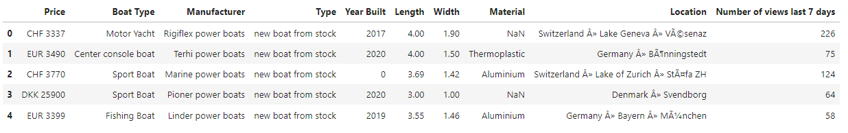
Motivation and Purpose
Which boats are most popular (according to the data)?
i.e. What kind of boats should be put in the weekly newsletter?
How?
I analyze the dataset of boat listings from Nearly New Nautical, a website that allows users to post their used boats for sale.
Primarily look at ‘Number of views last 7 days’ data as a measure of popularity.
Look for trends and insights from other features, such as: Price, Boat Type, etc.
Notes:
Hello, my name John. I am a Data Analyst for Nearly New Nautical and today I will be answering the question …
And indirectly, I will be answering…
Close to 10000 boats listed in the data set

Slide 4
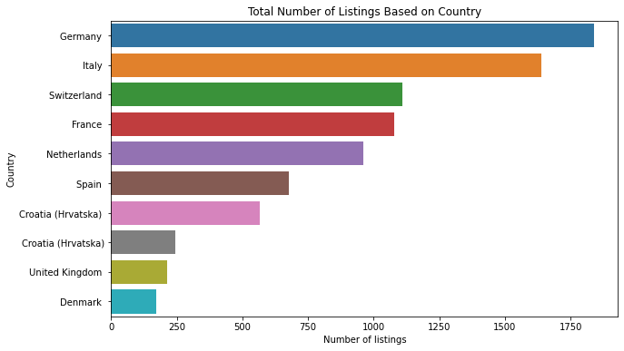
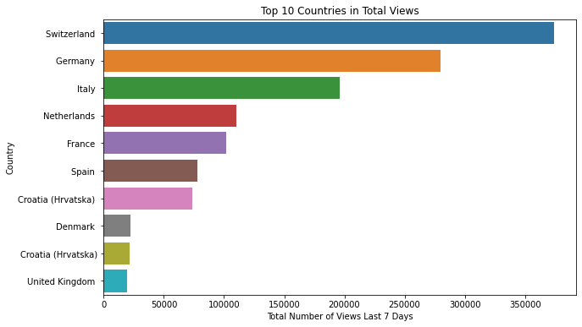
Where are boats mostly located?
Listings are located in 142 Distinct Countries
for 9888 total listings
Country | Count | Frequency (%)
Germany | 1839 | 18.6%
Italy | 1638 | 16.6%
Switzerland | 1109 | 11.2%
France | 1077 | 10.9%
Netherlands | 959 | 9.7%
However, boats listed in Switzerland have way more total views!

Slide 5
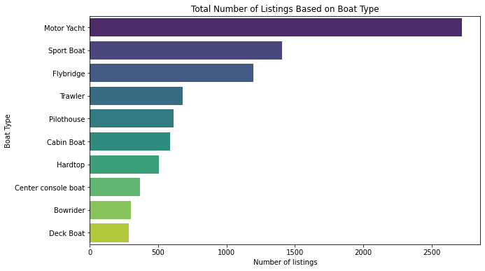
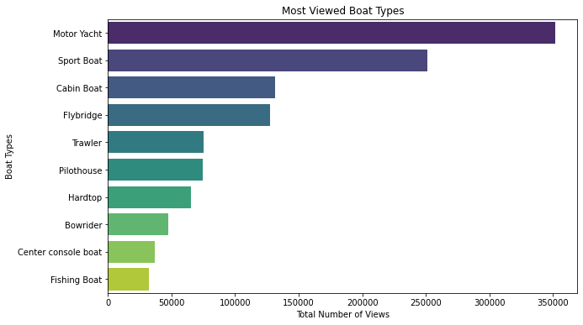
Most Popular Boat Types
126 Different Boat Types listed
Boat Type | Count | Frequency (%)
Motor Yacht | 2720 | 27.5%
Sport Boat | 1407 | 14.2%
Flybridge | 1194 | 12.1%
Trawler | 679 | 6.9%
Pilothouse | 613 | 6.2%
Most listed boat types also viewed more frequently.

Slide 6
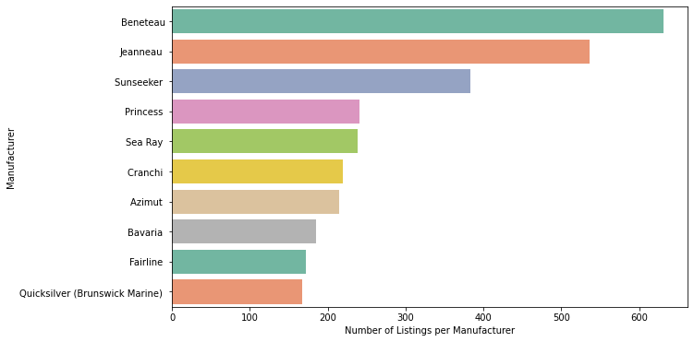
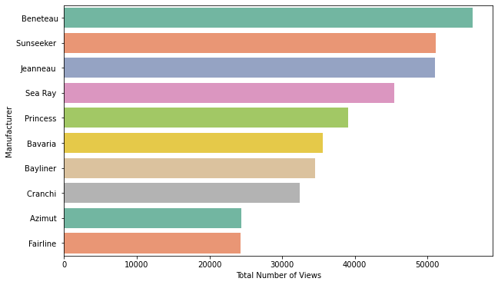
Is there a preference for boat manufactures?
910 Different Manufacturers for Boats
Manufacturer | Count | Frequency (%)
Beneteau | 631 | 6.4%
Jeanneau | 537 | 5.4%
Sunseeker | 383 | 3.9%
Princess | 241 | 2.4%
Sea Ray | 239 | 2.4%
Top boat manufacturers make up a small fraction.
There is a much larger number of manufacturers.

Slide 7
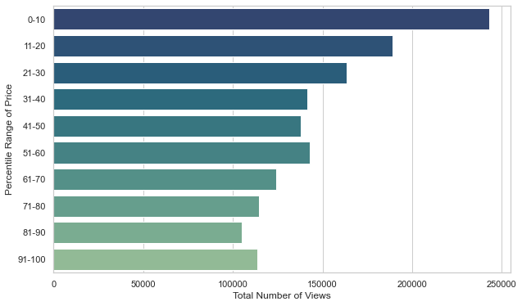
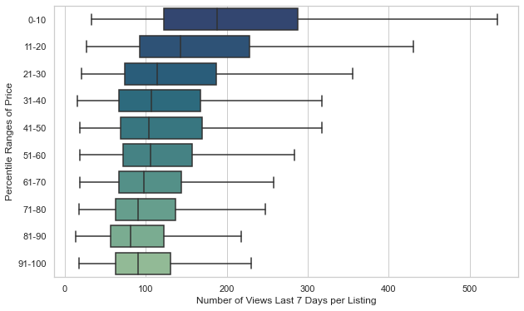
Cheaper boats tend to be more viewed
Expensive vs Cheap Boats
Price bins of percentile groups
Percentile Range | Min Price (Euro) | Max Price (Euro) | # of Listings in Price Range
0-10 | 3,223.0 | 21,078.9 | 989
11-20 | 21,078.9 | 35,147.0 | 989
21-30 | 35,147.0 | 49,900.0 | 1008
31-40 | 49,900.0 | 68,900.0 | 973
41-50 | 68,900.0 | 92,105.0 | 985
51-60 | 92,105.0 | 135,000.0 | 1020
61-70 | 135,000.0 | 199,000.0 | 1001
71-80 | 199,000.0 | 299,000.0 | 957
81-90 | 299,000.0 | 580,000.0 | 980
91-100 | 580,000.0 | 31,000,000.0 | 986
Notes:
The price data is first converted into common currency, which I chose Euros. The data is then subdivided into 10 percentile range subgroups to better visualize the aggregate affect it has on views.
Looking at the data there is a very noticeable trend….
This can easily be explained by the fact most people do not have infinite wealth. So generally people are more willing to look for and purchase cheaper boats, considering that it’s a luxury expense.

Slide 8
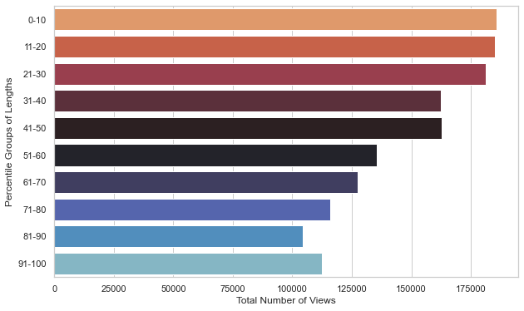
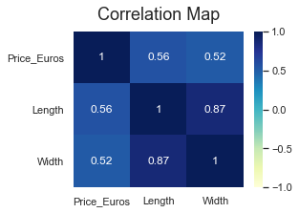
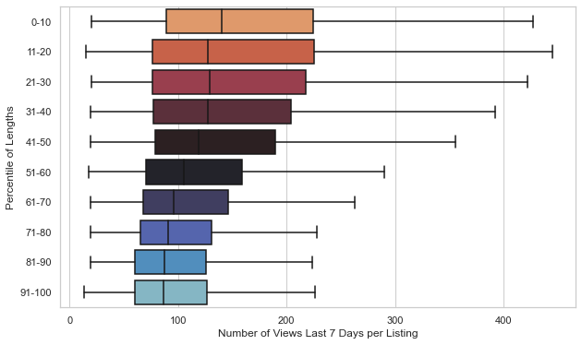
Smaller boats are also viewed more
What about size of boats?
Bins of percentile groups
Percentile Range | Min Length (m) | Max Length (m) | # of Listings in Length Range
0-10 | 0.04 | 6.00 | 1015
11-20 | 6.00 | 6.98 | 962
21-30 | 6.98 | 7.92 | 995
31-40 | 7.92 | 9.05 | 980
41-50 | 9.05 | 10.28 | 989
51-60 | 10.28 | 11.60 | 996
61-70 | 11.60 | 13.11 | 978
71-80 | 13.11 | 14.98 | 995
81-90 | 14.98 | 18.80 | 983
91-100 | 18.80 | 100.00 | 986
Strong correlations between Price, Length, and Width
Notes:
Similar analysis for length, the length data is put in it’s percentile subgroups and plotted for total number of views
We see a very similar trend to the price data, where…
Again, we can reason than smaller boats are more desirable due to its afforabilty.
Doing a correlation analysis, we can see that …
Width data is highly correlated with length, so we expect to see a similar trend… No need to analyze that

Slide 9
Conclusion of the project
Germany, Switzerland, Italy, France, Netherlands are countries with the most boats, making up more than 50% of all listings. Therefore the newsletter should be catered for these regions.
Motor yachts and sport boats are the most popular amongst boat types.
Most popular manufacturers are Beneteau, Jeanneau and Sunseeker.
Cheaper and smaller boats tend to get more views.
Caveats:
Number of views in last 7 days may not be an accurate measure of popularity for all listings. It’s possible that a very popular boat gets sold in less than 7 days, thus having a lower view count, therefore under counting the views.
Cheaper boats get more views because they are more affordable and more frequently purchased. However, more expensive boats are more representative of the latest boat technology and design, so its possible they will attract more readers in a newsletter.
Other unknown factors may have a strong influence on views, and hence popularity, but is not recorded in the dataset. e.g. mileage of a boat

Slide 10
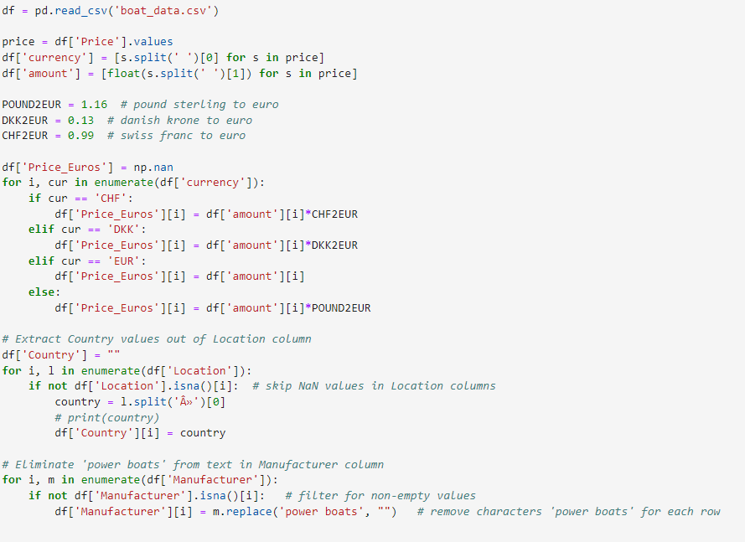
Technical details
Sample of the Python code used for data cleaning
Everything was done in Python
Pandas and NumPy for data cleaning and data wrangling
Matplotlib and Seaborn for data visualization
Initial data cleaning and wrangling
The price column was in string format and in different currencies
Created a new column that has all the prices in Euros and in integer format
Year column had 0 for NaN values
Location column had non-English characters
The strings were replaced, and the countries data were extracted from this column
Boat Type had redundant values
Price had to be separated into 10 percentile groups

Slide 11
Thank you for listening
Analysis was done with Python on Datacamp Workspace
For more details on the analysis, data cleaning, and visualization, feel free to contact me at: johnkitfeng@gmail.com

